Slide 1
Database Internals meets PowerBI
Patrick Flynn | Link Group Australia

Slide 2

















A big thanks to all of our sponsors!

Slide 3




Patrick Flynn SQL Server DBA Link Group
MCM – SQL Server 2008
MCSM – Data Platform
Production DBA for 10+ years.
https://github.com/sqllensman/Presentations
sqlsaturday@sqllensman.com
@sqllensman
Patrick Flynn
#746 | Oslo 2018

Slide 4
Agenda:
Review of Database Internals
“Basic Commands”
Demo

Slide 5
TOOLS OF TRADE

Slide 6
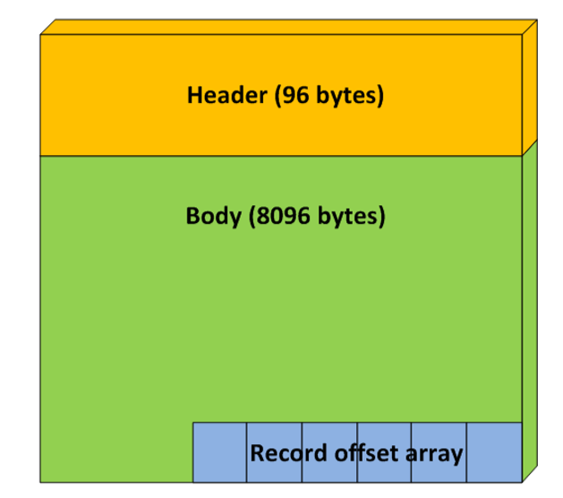
Structure of Page

Slide 7
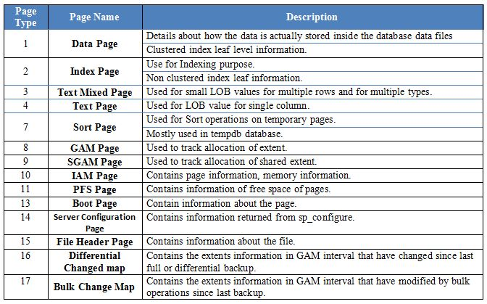

Slide 8
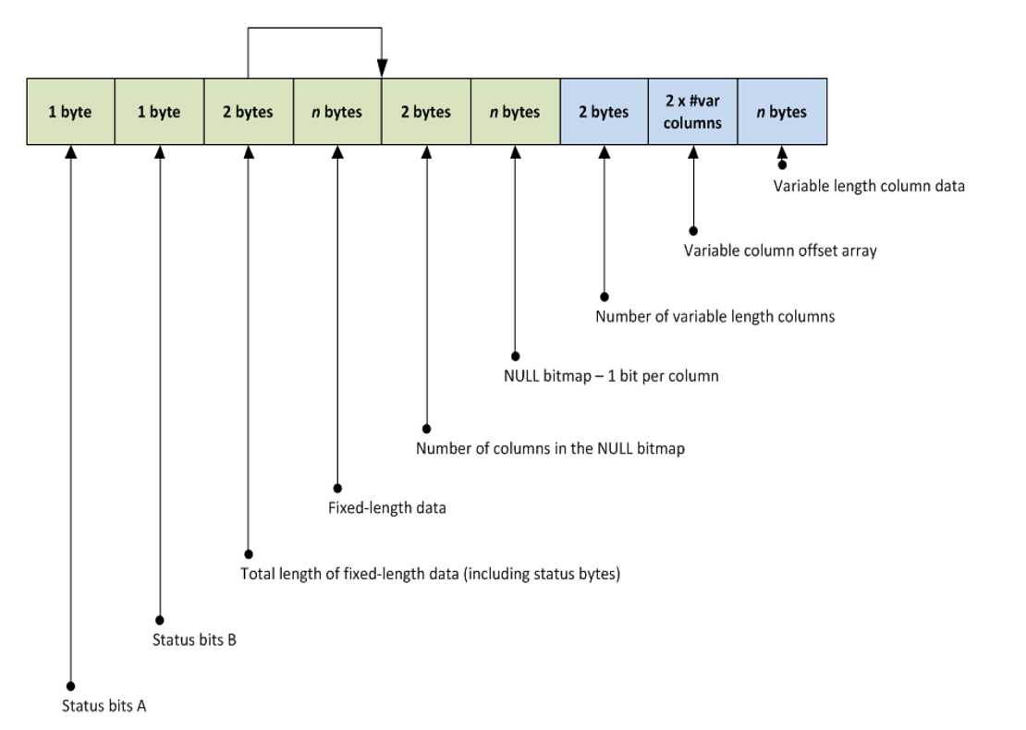
Page Structure at Byte Level
Data Record
Notes:
http://improve.dk/deciphering-a-sql-server-data-page/
http://aboutsqlserver.com/2013/10/15/sql-server-storage-engine-data-pages-and-data-rows/

Slide 9
Tools of Choice
sys.fn_PhysLocCracker
DBCC IND
DBCC PAGE
sys.fn_PhysLocFormatter
sys.system_internals_allocation_units
sys.system_internals_partition_columns
sys.dm_db_database_page_allocations
Notes:
Trace Flags: 3604

Slide 10


Slide 11
Social
Make sure you tweet on #SQLSat746 or #SQLSatOslo
Don’t forget to thank Volunteers and other Speakers!

Slide 12

Thank you for attending #SQLSATOslo

